Slide 1
Section 7.3 Ratio and Proportion
A ratio is an ordered pair of real numbers, written a:b, with b ≠ 0.
Remark
You should remember that a fraction is also an ordered pair of numbers a and b with b ≠ 0, except that a and b must be integers.
In other words is a ratio, but is not a fraction.

Slide 2
Ratios
Recall that a fraction is always used for part-to-whole comparison, but a ratio can be used for
part-to-part comparison
part-to-whole comparison
other comparisons such as distance-to-time.

Slide 3
Ratios
Equality of ratios
Two ratios a:b and c:d are equal if and only if
a ×d = b ×c
i.e. a : b = c : d if and only if
inside×inside = outside×outside
A proportion is a statement that two given ratios are equal.

Slide 4
Proportions
A proportion is a statement that two given ratios are equal.
Practical examples that need proportions:
If a cocktail recipe calls for 1 part of 7-up and 2 parts of orange juice, then you need to use the same ratio (no matter how much of cocktail wanted) in order to keep the taste consistent.
If you are mixing paint to paint your house, you need to keep the ratio (of color pigments to white paint) constant to ensure that the color will remain exactly the same.

Slide 5
Proportions
Practical examples:
If city tax rate is $7.75 to every $100 of purchase, then you have to use the same ratio no matter how much your purchase is (because it is the law).
If you want to enlarge a 4”×5” picture, then you should keep the same ratio in dimension to avoid distortion.

Slide 6
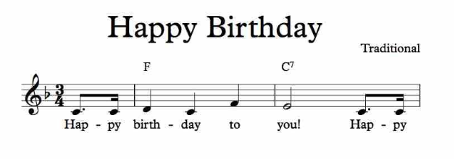
Proportions
Practical examples:
5. In music, it is the ratio of frequencies that determines the relative pitch. And we need to keep the same ratio if we want to transpose a piece of music (i.e. change to another key)
(in G key)
(in F key)

Slide 7
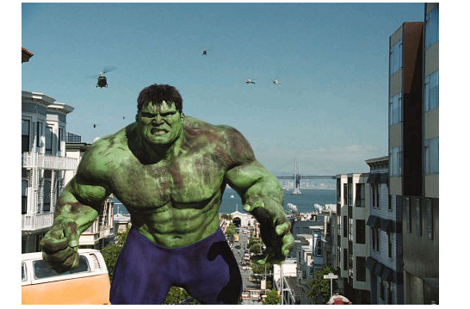
Some situations where proportions are less understood.
1. Can Giants exist?
Most of us like to watch movies and animations of giants or gigantic animals.
But can we simply increase the size of a person (or an animal) and yet expect all other physical properties to remain the same?

Slide 8
Some situations where proportions less understood.
1. Can Giants exist?
If we triple the size of a cube using the same material, the pressure (lb/ft²) on the bottom of the cube will become 3 times as big even though the foot print of the
big cube is bigger.

Slide 9
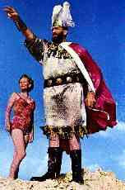
Some situations where proportions are less understood.
1. Can Giants exist?
Consequently, if a giant has the same body shape as a normal person and yet 3 times as high, his feet will take 3 times of the normal pressure, and his blood pressure has to be 3 times as high to pump blood from the feet back to his heart.
This will put too much stress on the
body and hence giants cannot live long
if they ever exist.

Slide 10
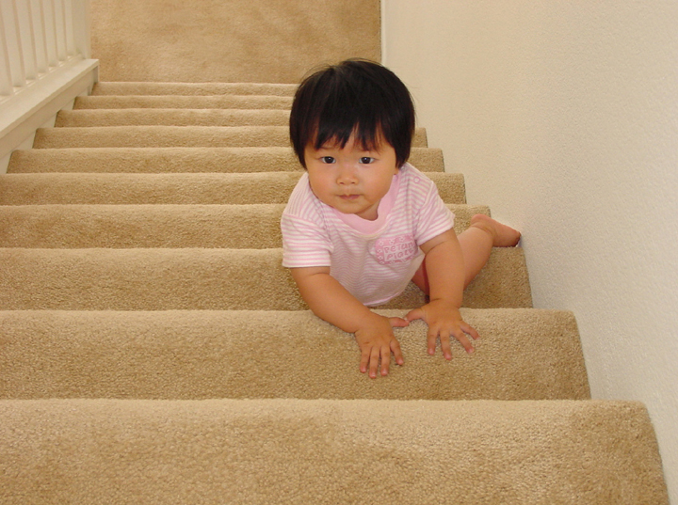
Some situations where proportions are less understood.
2. Why babies can craw on their knees for a long time?
On the other end of the spectrum, if a baby is only 1/3 of our height, then the pressure on its knees will be only 1/3 of ours, and such a small pressure will not cause pain in the knees.

Slide 11
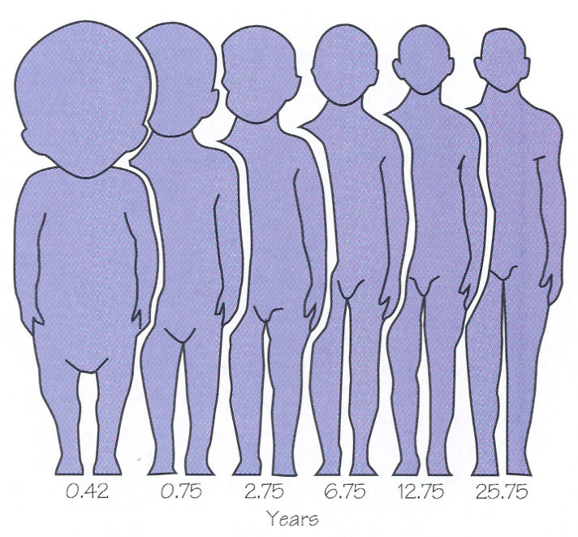
Some situations where proportions are less understood.
3. Are babies just miniature adults?
No, a baby’s body parts have proportions very different from those of adult’s.
For instant, a baby has much smaller
arm length / body length
ratio than that of an adult.

Slide 12
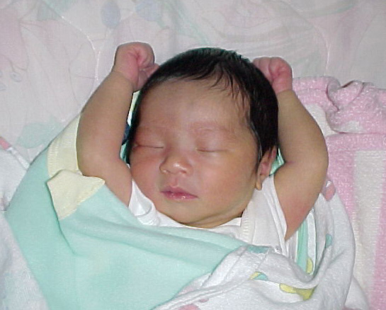
Some situations where proportions are less understood.
3. Are babies just miniature adults?
No, a baby’s body parts have proportions very different from those of adult’s.
For instant, a baby has much smaller
arm length / body length
ratio than that of an adult.

Slide 13
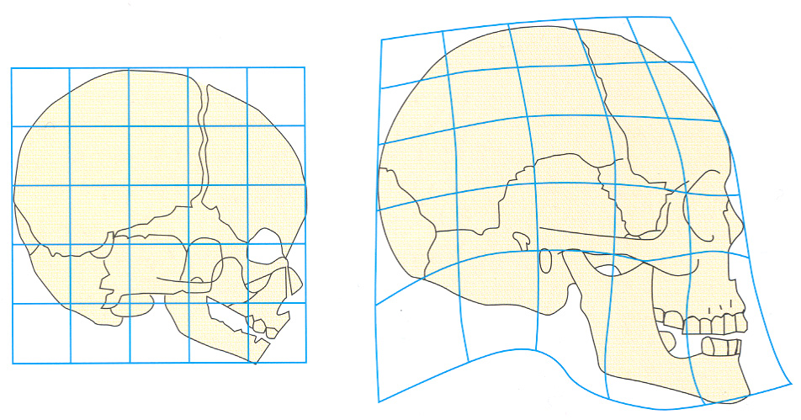
Some situations where proportions are less understood.
4. How does the face change with age?
The skull does not grow proportionally, hence the face does not simply enlarge when a child grows up.

Slide 14
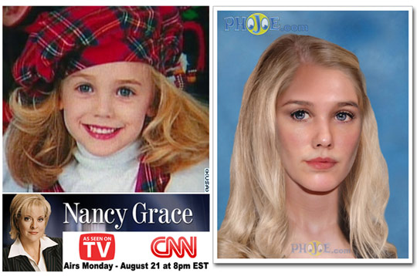
Age Progression and Regression Photos
JonBenet Ramsey Age Progressed from Age 6 to 16
Link

Slide 15
Can Giants exist?
Tallest man ever lived.
8 feet 11.1 inches
Tallest man alive, 2009.
(8 ft 1 in)

Slide 16
Section 7.4 Percent
Math word
Percent means per hundred, or part of 100.
The symbol for percent is %
Percent is always a part-to-whole comparison, and the whole is divided into 100 congruent pieces.
Example
37% means 37/100, which means 0.37

